Slide 1
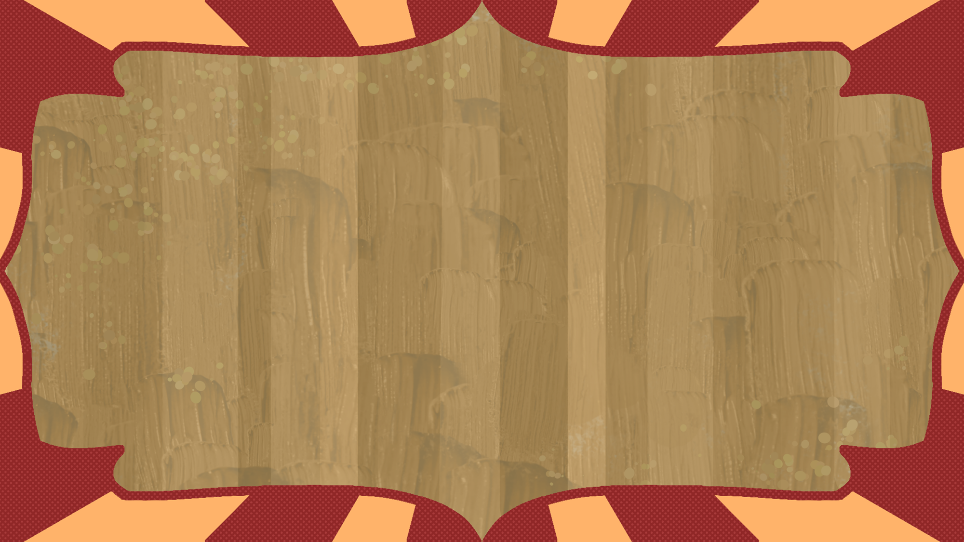
DCC ↔ Unity Live Sync
By: Riley Foster

Slide 2

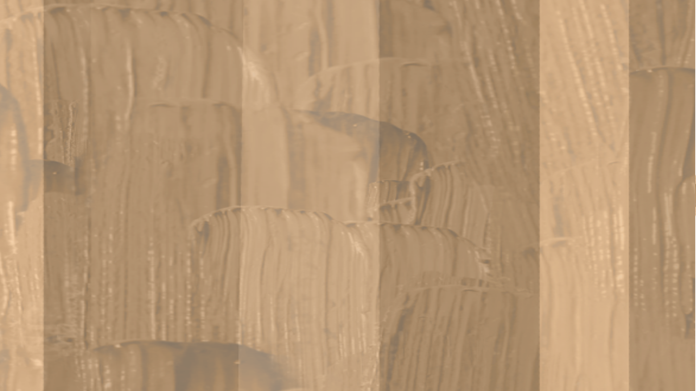
What?
Why?
How?
My project is a live link service that syncs models, materials, animations, and other updates from your DCC (Digital content creation) tools to Unity in real time. This removing the need for manual reimports and streamlining asset development.
Unlike Unreal’s live link or Unity’s outdated MeshSync, this tool offers up-to-date, seamless integration to boost productivity and simplify the asset editing process.
This is a two-part system that connects *For now* Blender (Python) and Unity (C#).
Blender detects model or material changes, serializes them into binary, and sends them via real-time sockets.
Unity receives the data and updates meshes directly using the Mesh API, skipping imports.
Edits in Blender instantly appear in Unity, creating a seamless live link.

